Slide 1
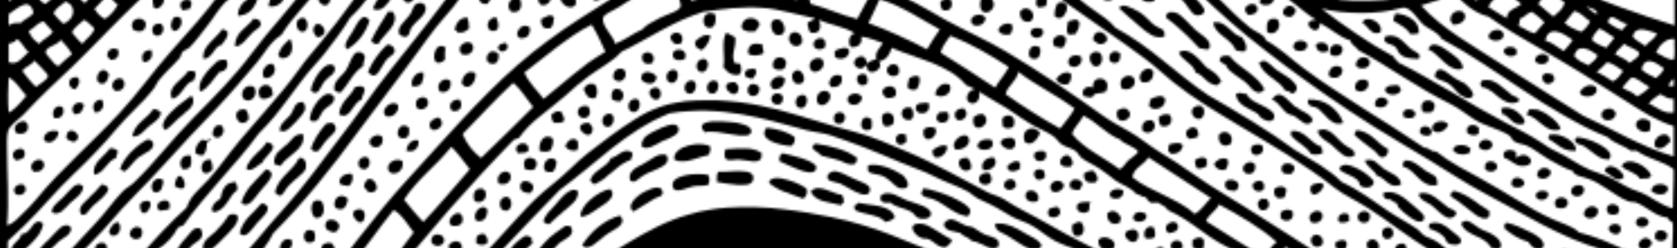
Secrets to Modeling Groundwater Flow through Dipping Hydrogeologic Layers
By Christian Langevin
Coauthors: Alden Provost, Kerry Bardot, and James McCallum
Delft University, The Netherlands
November 30, 2023
Notes:
Sloping/undulating hydrogeologic layers can be represented using several different approaches: grid overlay, flexible meshes, vertically offset model layers
Vertically offset model layers violate CVFD requirements, and so we expect some loss of accuracy. Also, in MODFLOW, vertical offsets are not included in the distance calculation between cell centers
XT3D is multi-point flux approximation designed to handle full 3D anisotropy, but it also improves the accuracy for grids that violate CVFD requirements
Example problem designed to test TPFA and MPFA for sloping layers. We should expect MPFA to do well.
Results show both TPFA and MPFA are not great
Description of grids in MODFLOW 6: DIS and DISV are layered grids, but DISU has full flexibility
Maybe a grid that is fully connected can be used to improve the results? Python script written to create a fully connected DISU grid from a DIS/DISV grid
Yes, TPFA and MPFA are both significantly improved with a fully connected grid. Need at least 2 model layers.

Slide 2
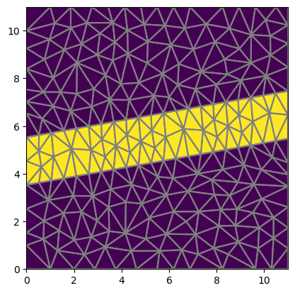
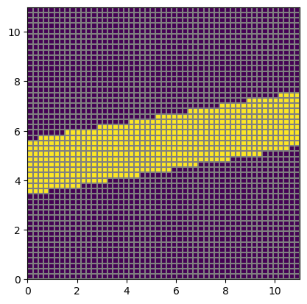
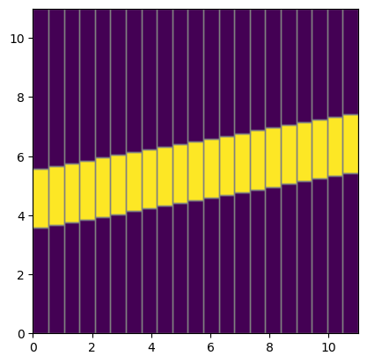
Approaches for Representing Dipping Layers
Conforming Mesh
Rectilinear Grid Overlay
Vertically Offset Grid

Slide 3
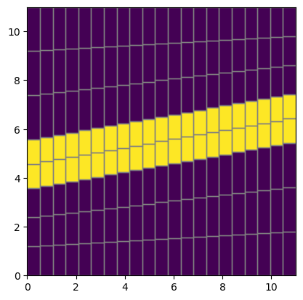
Problems with Vertically Offset Cells
Approximate Flow
Distance (L)
Geometric
Irregularity
L
Connecting line between cell centers does not bisect shared face at a right angle
10 degrees is recommended as the upper limit for sloping layers.
Q =
KA(h₁ – h₂)
L
Can we improve the accuracy?

Slide 4
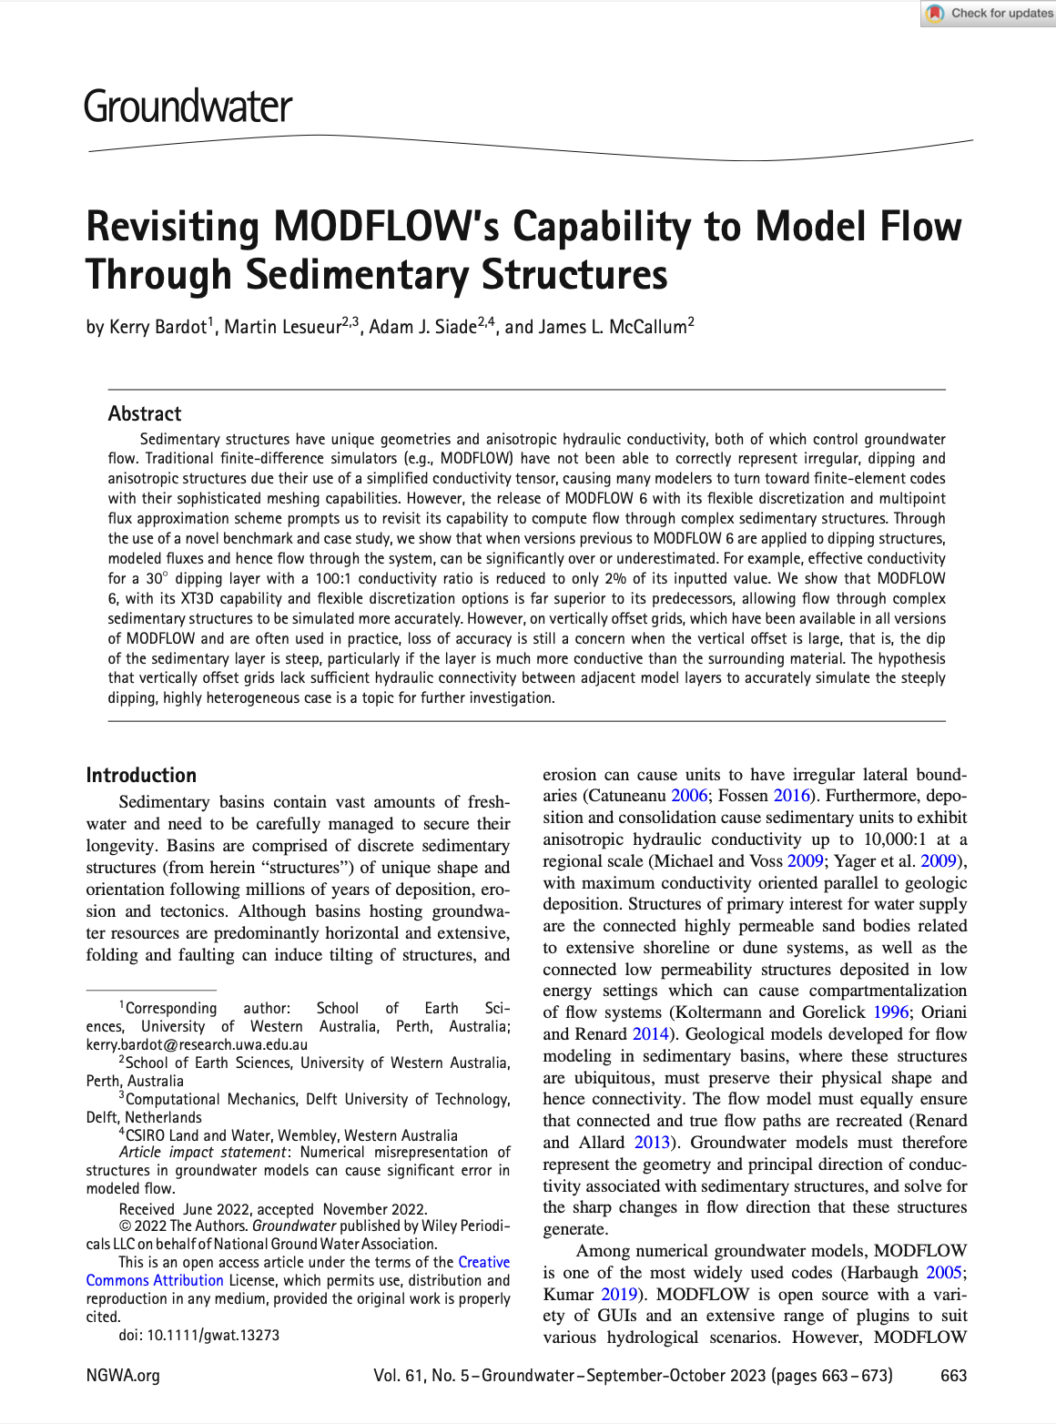
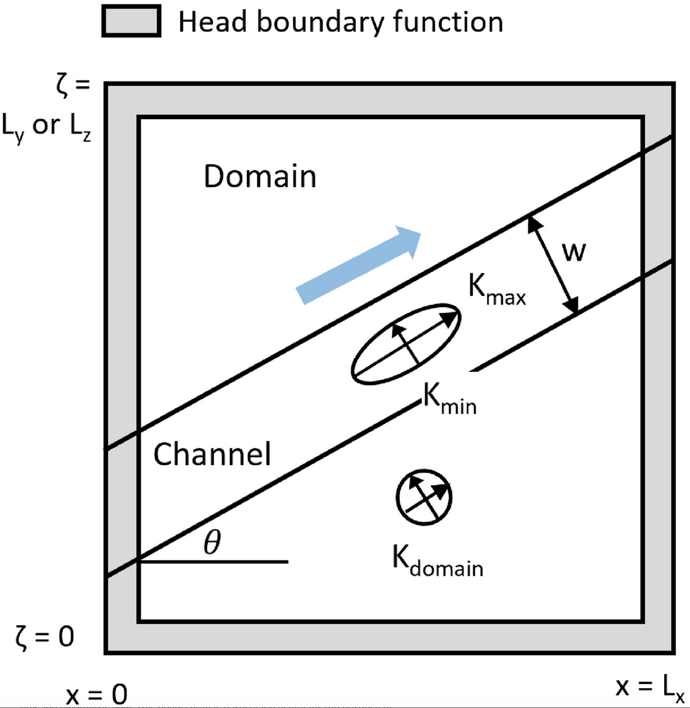
Example

Slide 5



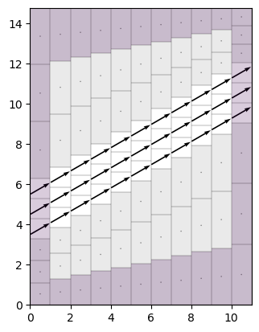
Performance Metrics
Magnitude of specific discharge in the center of the permeable feature
Angle of the specific discharge vector in the center of the model domain
Error in the rate of groundwater flow through the permeable layer
|q_{s}| = 1 m/d
𝛼_{s} = 30 degrees
(Q_{s} - Q_{a} )/ Q_{a} = 1

Slide 6
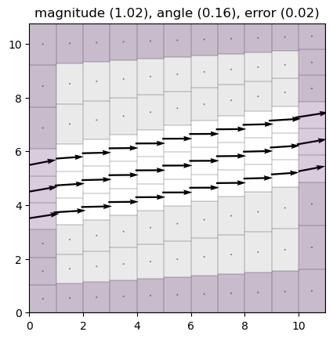
10-Degree Dip
|q_{s}| = 1.02 m/d
𝛼_{s} = 0.2 degrees
(Q_{s} - Q_{a} )/ Q_{a} = 0.02

Slide 7
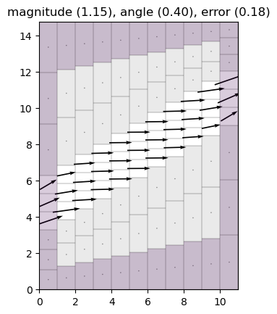
30-Degree Dip
|q_{s}| = 1.15 m/d
𝛼_{s} = 0.4 degrees
(Q_{s} - Q_{a} )/ Q_{a} = 0.18

Slide 8
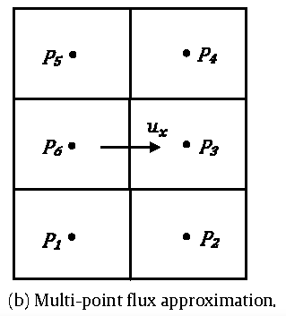
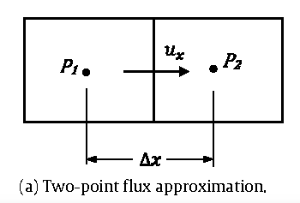
Flux Approximations in MODFLOW
MODFLOW 6 has two different ways to calculate the flow between two cells:
Two-point “standard” flux approximation (standard)
Multi-point XT3D flux approximation (XT3D)
Notes:
MODFLOW 6 has two different ways to calculate the flow between two cells: a two-point flux approximation (as shown on the left) or a multi-point flux approximation (as shown on the right).

Slide 9
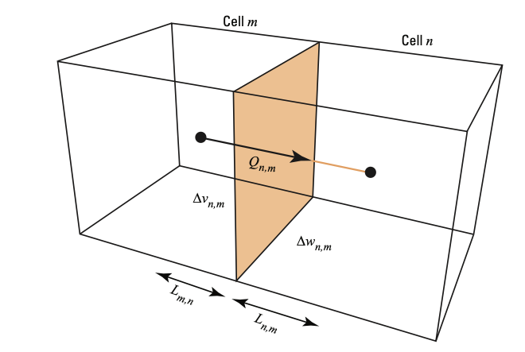
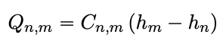
Two-Point Flux Approximation
Flow between cells is calculated using the head difference between the two cells
Standard two-point approach works well for most problems
Notes:
With the two-point flux approximation, flow between two cells is calculated based on the head difference between the two cells. This is the common approach, and it works well for most problems.

Slide 10
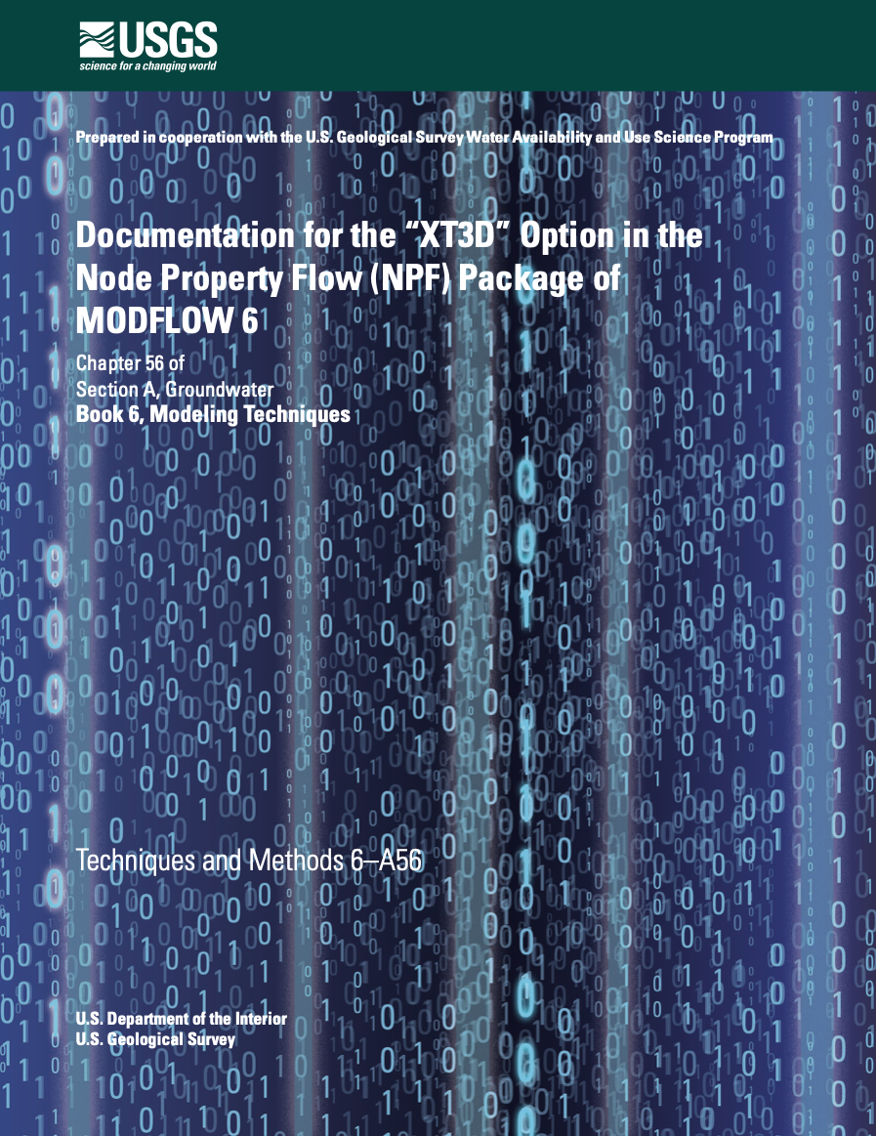
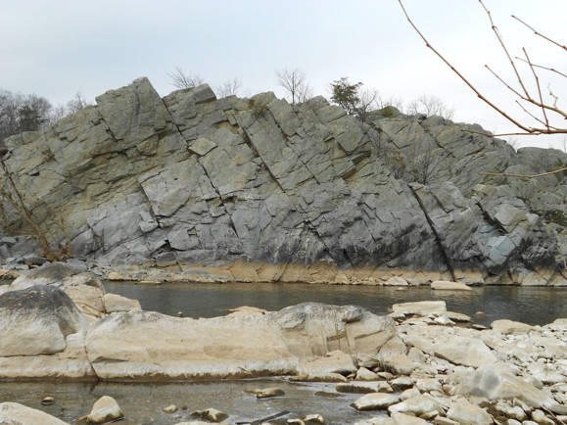
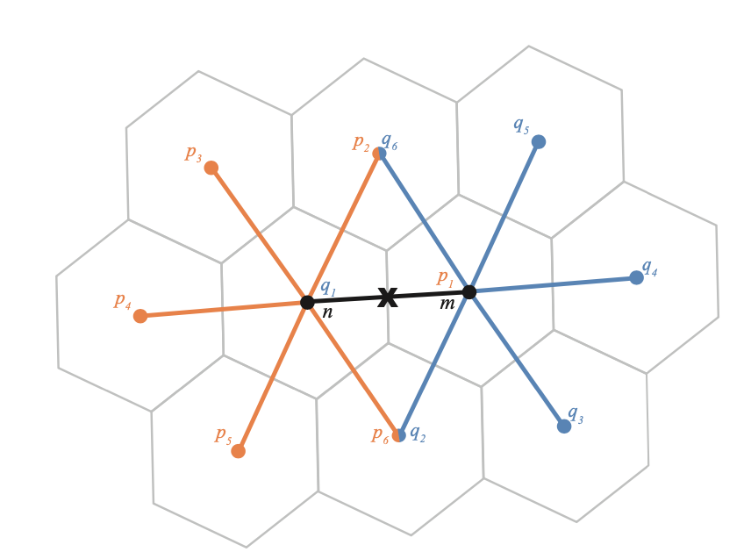
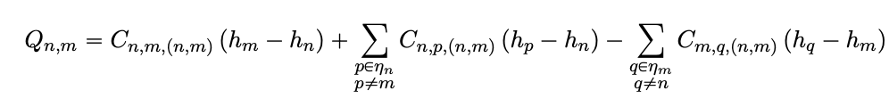
Multi-Point XT3D Flux Approximation
Gradient reconstruction method (Provost et al. 2017)
Originally developed to represent anisotropic groundwater flow
Improves accuracy for grids with irregular geometric connections
Computationally more expensive than two-point standard approximation
Notes:
MODFLOW 6 also has a more sophisticated multi-point flux approximation, which is designed for anisotropic groundwater flow on structured or unstructured grids. We call this XT3D. Although XT3D is computationally demanding, it provides a more accurate solution than the two-point approximation for some grid types. As shown in this diagram, the flow between cell n and m depends on the head difference between cell n and m, but also on the heads in surrounding cells.

Slide 11

Multi-Point XT3D: 10-Degree Dip
|q_{s}| = 1.01 m/d
𝛼_{s} = 0.2 degrees
(Q_{s} - Q_{a} )/ Q_{a} = 0.02

Slide 12
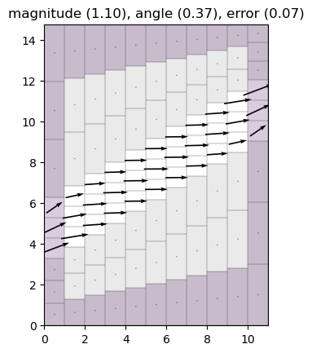
Multi-Point XT3D: 30-Degree Dip
|q_{s}| = 1.10 m/d
𝛼_{s} = 0.4 degrees
(Q_{s} - Q_{a} )/ Q_{a} = 0.07

Slide 13
Grid Connectivity
Layered Grid
Fully Connected Grid
Maybe we can add additional connections?
Horizontal connections are only for cells in the same model layer

Slide 14
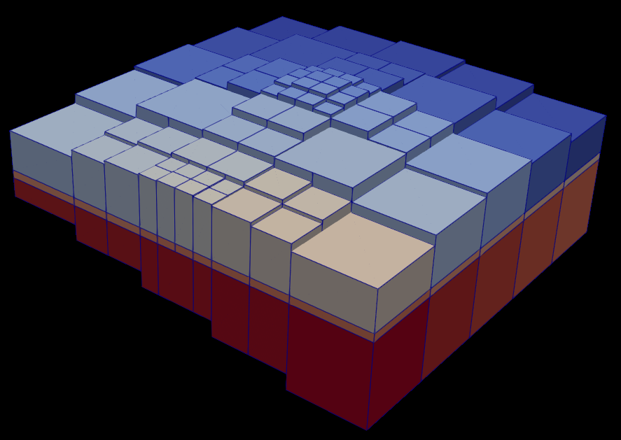
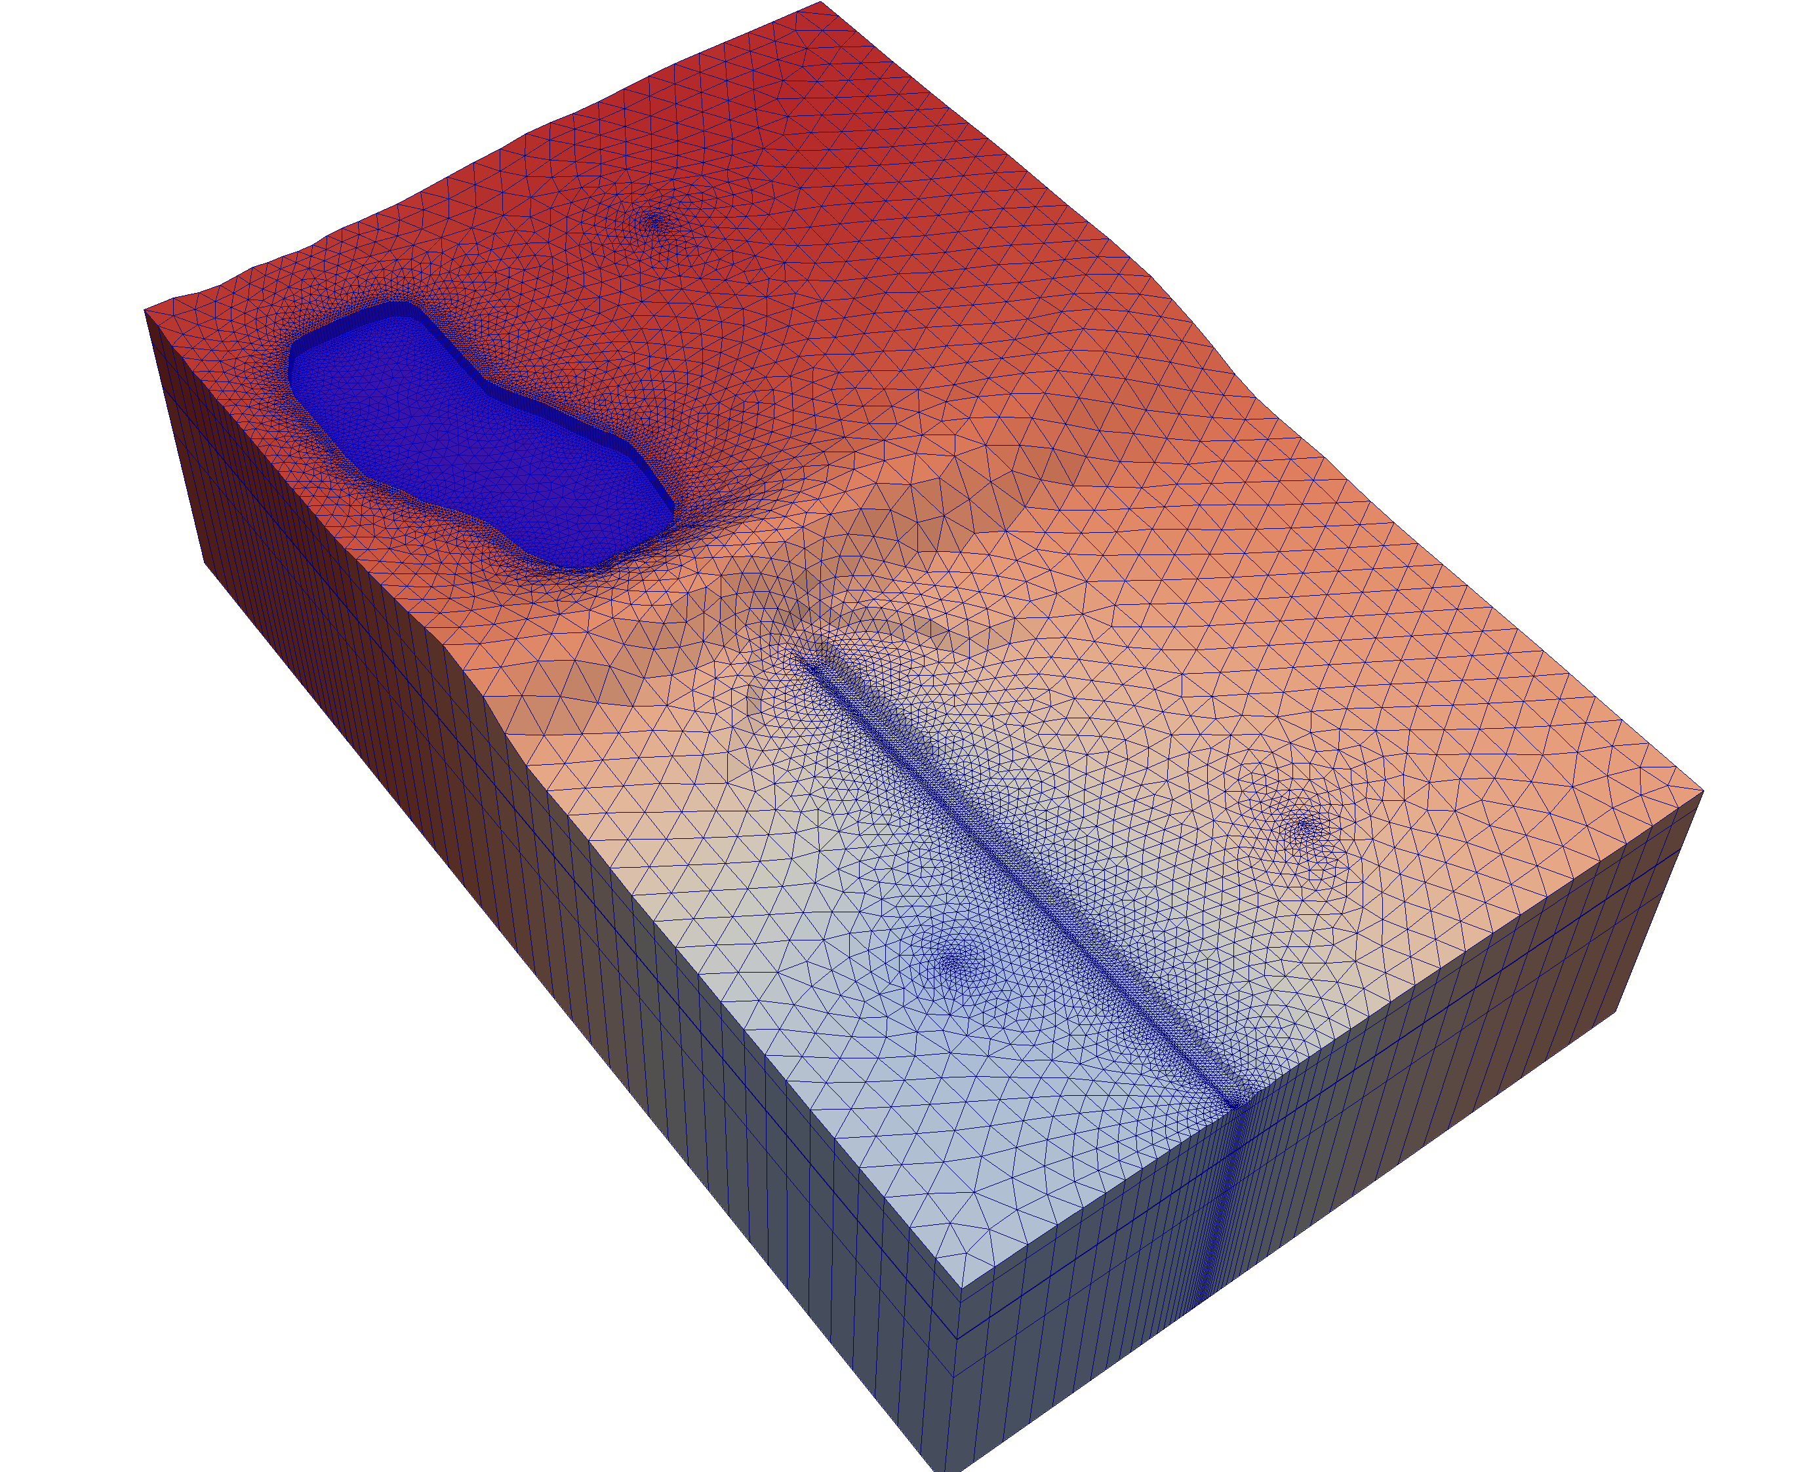
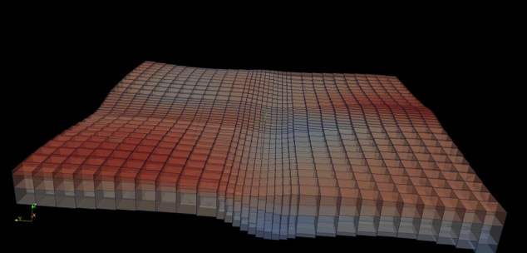
Discretization Types in MODFLOW 6
DIS
(Regular Grid)
DISV
(Layered Unstructured Grid)
DISU
(Fully Unstructured Grid)
”Layered” = same grid applies for each layer,
and horizontal connections are within a layer
No formal layer concept;
Connections specified by user
Notes:
The groundwater flow model in MODFLOW 6 supports three different grid types. We refer to them as DIS, DISV, and DISU. DIS is for a traditional MODFLOW grid that consists of layers rows and columns. DISV stands for discretization by vertices. With DISV, the user must define each cell by its vertices. DISV also requires that the same mesh applies to each model layer. DISU is the most flexible of the grid types. With DISU, the user provides information about each cell, how cells are connected, and the geometric properties of the connections.

Slide 15
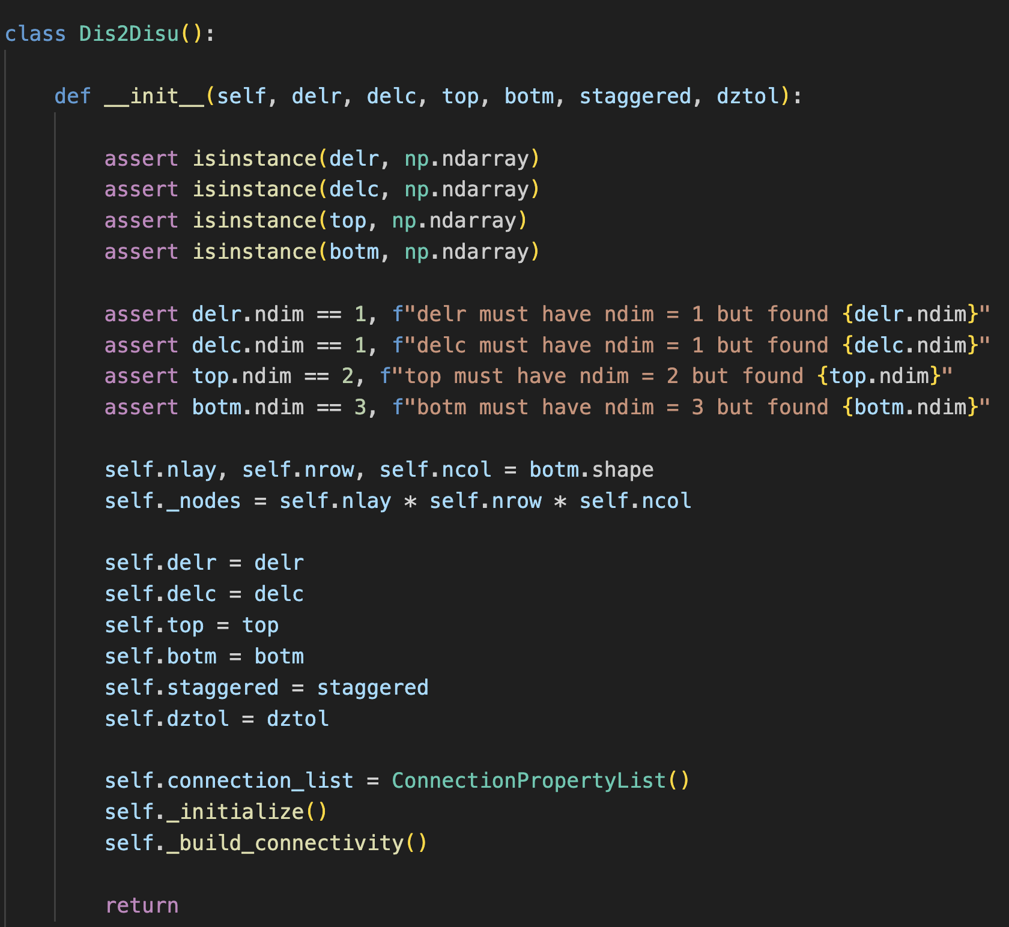
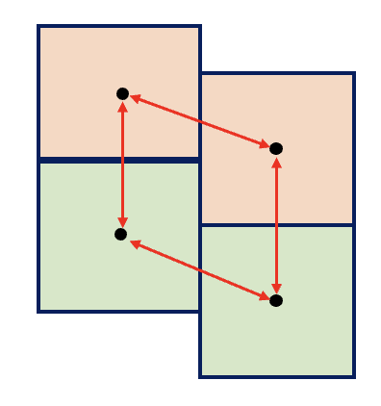
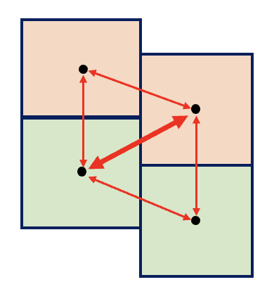
Python Dis2Disu Converter
DIS
DISU

Slide 16
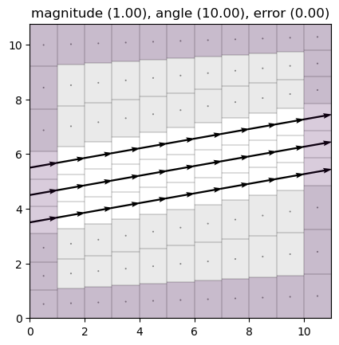
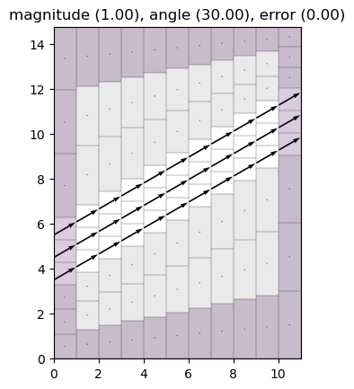
Multi-Point XT3D – Fully Connected Grid
10-degree dip
30-degree dip

Slide 17
Results Summary: 30-Degree Dip
Standard Two-Point
DIS--Layered Connectivity
Multi-Point XT3D
DIS--Layered Connectivity
Multi-Point XT3D
DISU--Full Connectivity

Slide 18
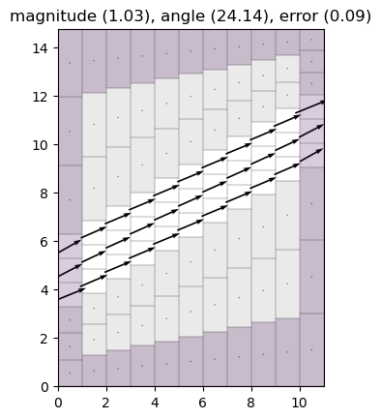
What about Standard Two-Point Approximation with Full Connectivity?
30-degree dip
|q_{s}| = 1.03 m/d
𝛼_{s} = 24.1 degrees
(Q_{s} - Q_{a} )/ Q_{a} = 0.09

Slide 19
Conclusions
The secret to accurately modeling flow through dipping layers is to use the Multi-Point XT3D Formulation with a fully connected DISU grid
If XT3D is not an option, then a fully connected DISU grid will also improve results for the standard two-point formulation
Permeable layers should be discretized into at least two model layers
May be worthwhile to implement a “full connectivity” option for DIS and DISV grid types in MODFLOW 6

